Slide 1


Health Economics Lecture #1
Topic: An Introduction to Health Economics MSMG 5240
Prepared by Jacob Smith, Trent University

Slide 2
Learning Objectives
In this lecture we will discuss:
What is Economics?
What is health economics?
Health Expenditures in Canada and the World: A Comparative Overview
Comparing Healthcare Systems- Costs
Comparing Healthcare Systems- Health Outcomes
Comparing Healthcare Systems- Wait Times and Access to Care
Social Determinants of Health
Goal of this Lecture:
Introduce you to Health economics and why its an interesting field to work in.
get you familiar with the kind of data we look at in Health Economics.

Slide 3
What is Economics?
An introduction to the subject and scholarly community

Slide 4
What is Economics?
Economics is a behavioral science that studies the production, distribution, and consumption of goods and services.
A shorter definition is that Economics is the study of the allocation of scarce resources.
An eve shorter definition is that economics is the study of WHAT, goes WHERE and WHY.
What- Goods and Services
Where- Consumers, Producers and Governments
Why- Consumer’s Willingness to Pay, Producers willingness to accept or because the government said so.
When we start discussing the tools of economics in the next lecture, this last definition will make the most sense.

Slide 5
Branches of Economics
There are two branches of economics Microeconomics and Macroeconomics.
Microeconomics studies allocation decisions by consumers and producers and how they interact in markets.
Macroeconomics studies economies through their aggregates such as GDP, Inflation and unemployment rate.
Health Economics is a subfield of Microeconomics so the tools there will be most relevant however there have been some macro applications in the recent past (with reference to lockdown policy during covid).

Slide 6
What is Health Economics?
An introduction to the subject and scholarly community

Slide 7

A Short History of Health Economics
Health economics is a subdiscipline of economics which studies the allocation of scarce resources in healthcare environments.
Most credit the creation of the research program of health economics due to Ken Arrow’s 1963 Publication: “Uncertainty and the welfare economics of medical care”.
The provision of medical services is different than the provision of all other goods is because by nature the market is full of Information Asymmetry and often there is no direct compensation between patients and physicians (this relationship is often mitigated by an insurance company).
Ken Arrow: Nobel Prize Winner 1972

Slide 8
Characteristics of Health Economists
Health economics is further unique because unlike other fields of economics, it is the most interdisciplinary in the sense of there being lots of people outside of economics departments doing this work.
You’ll often see people who work as health economists that come from schools of public health and economics departments with the former typically dominating industry jobs.
The reason? Questions of resource allocation naturally come up when talking about ways to improve population health.

Slide 9

Health Economics VS Health Technology Assessment
Health Economics
Health Technology Assessment
Studies how Economic policies impact population health outcomes and Institutions which provide medical services.
Studies how to bring new treatments and therapies to market by defining a drug’s value for money.
Topics Include:
How much will funding of a drug cost? (Budget Impact analysis)
Some questions we address here are:
Can a smoking tax make smoking less appealing?
What economic factors determines the health and longevity of people?
Does physician practice style change when we change their compensation structure.
What is a drug’s value for money? (Cost effectiveness analysis)
$$λ$$

Slide 10
Some Unique Features of Health Economics
Some more ways that health economics is unique include:
It’s a field that actively involves non economists (mostly those from schools of public health or med schools).
Most policy variables are non-numeric (Most applied questions are fund vs don’t fund).
When they are numeric there is a vast (as seen in the schedule of medical benefits)
The kind of bargaining for medical services are often not direct and involve the use of third parties such as insurance companies.
This is a field that makes interpersonal comparisons of utility (i.e. we often value the wellbeing of one group against another).

Slide 11








Some Famous Health Economists
Jonathan Gruber
Michael Grossman
Amy Finkelstein
Victor Fuchs
Mark Pauly
Michael Drummond
Evelyn Forget
Han Bleichrodt

Slide 12



Professional Organizations

Slide 13
Health Expenditures in Canada and the World: A Comparative Overview

Slide 14
Thinking about healthcare systems
The first line of thinking about health economics is to think along two dimensions.
These are:
Costs
Health Outcomes.
While this wont tell the full story, it will provide a map for where to start looking.
The next couple of slides will go over this in particular.

Slide 15
Comparing Healthcare Systems- Costs

Slide 16
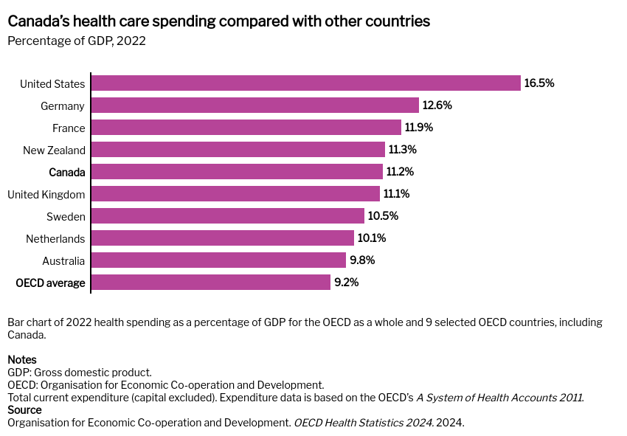

Slide 17
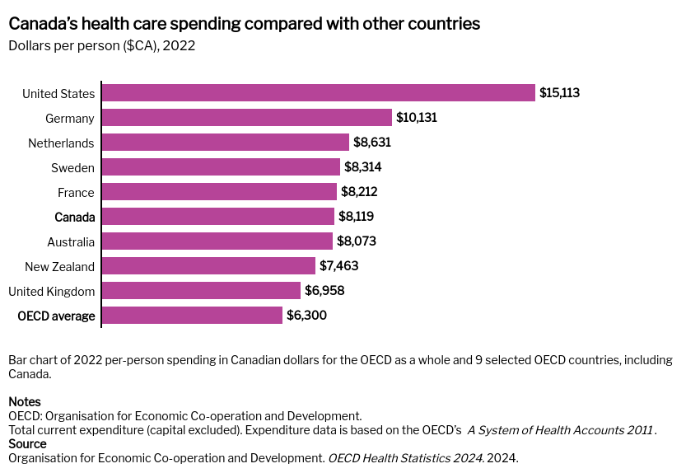

Slide 18
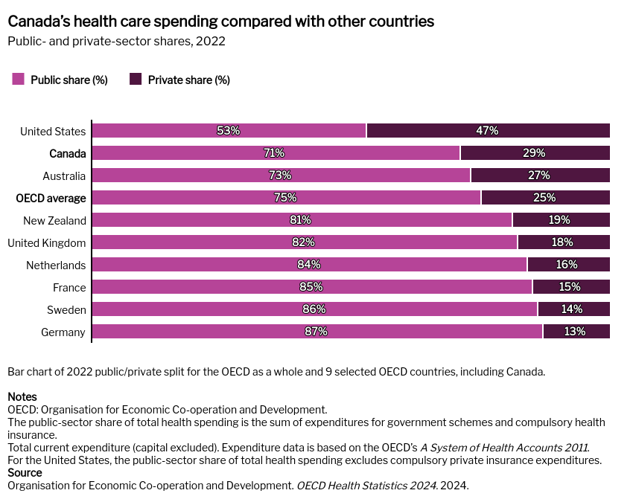

Slide 19
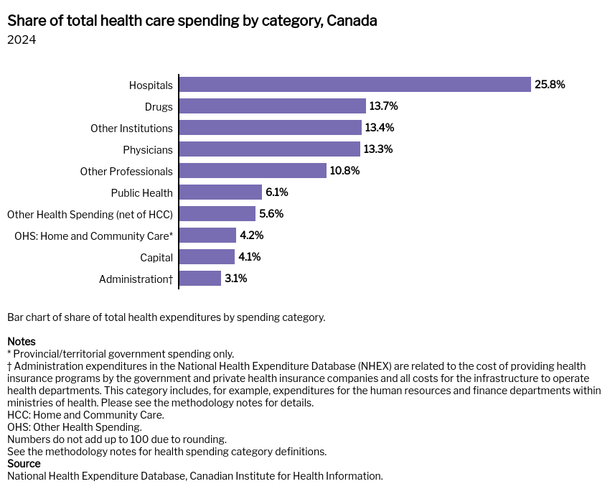

Slide 20
Summary of findings on health system costs.
As of 2022, approximately 11.2% of Canda’s GDP makes up healthcare spending.
Hospitals make up the largest share of health care spending around 25%
The United states spends nearly double Canada’s GDP per capita for health care.
The private share of healthcare expenditure in the US is the largest among OCED countries.

Slide 21
Comparing Healthcare Systems- Health Outcomes

Slide 22
Source: https://www.oecd.org/en/data/indicators/life-expectancy-at-birth.html

Slide 23
OECD (2023), Health at a Glance 2023: OECD Indicators, OECD Publishing, Paris, https://doi.org/10.1787/7a7afb35-en.

Slide 24
Source: https://www.oecd.org/en/data/indicators/suicide-rates.html?

Slide 25
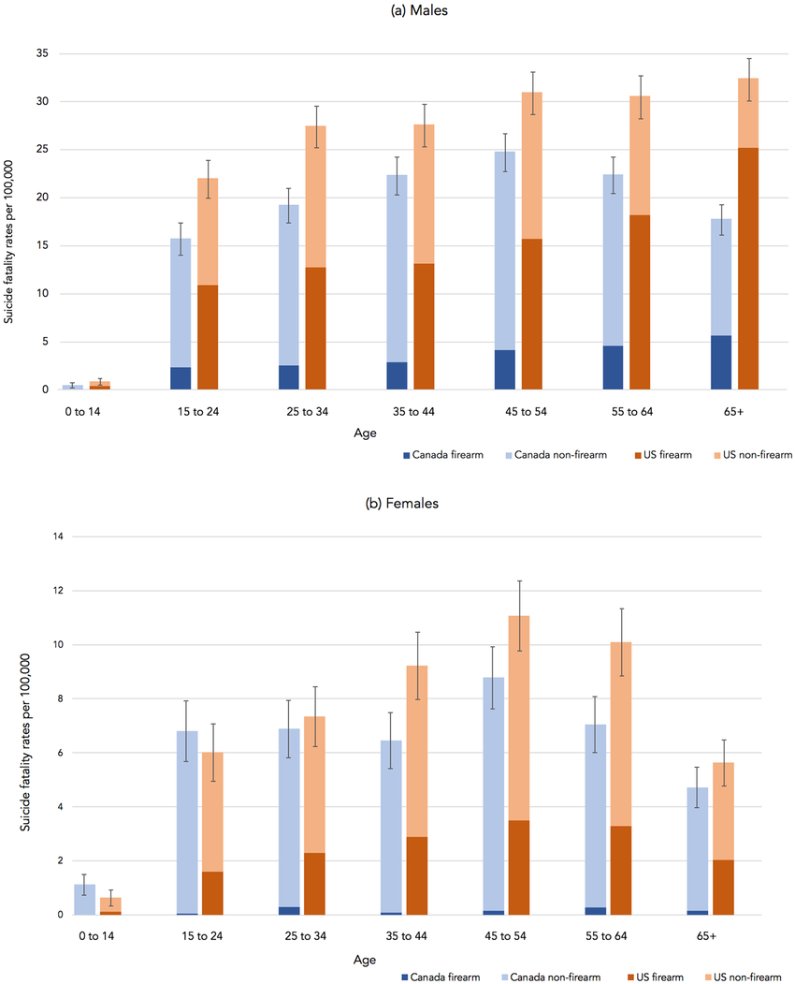
Firearm and Non-Firearm Suicides: Canada VS United States 2016
Source: Raifman, J., Sampson, L., & Galea, S. (2020). Suicide fatalities in the US compared to Canada: Potential suicides averted with lower firearm ownership in the US. PLoS one, 15(4), e0232252.

Slide 26
Source: https://www.oecd.org/en/publications/addressing-problematic-opioid-use-in-oecd-countries_a18286f0-en/full-report/component-6.html#chapter-d1e392

Slide 27
Source: https://www.oecd.org/en/data/indicators/deaths-from-cancer.html

Slide 28
Summary of Results on Health Outcomes
Those in the United states appear to have a shorter life expectancy than other OCED countries.
This mostly due to illicit drug use and higher suicide rates.
Higher suicide rates have a lot to do with access to “lethal means” such as firearms.

Slide 29
Comparing Healthcare Systems- Wait Times and Access to Care

Slide 30
A word on wait times
The market for medical procedures is unique as often there is no direct bargaining over the price of a procedure.
Bargaining Is often mitigated through a third party payer (be this private or public insurance).
One of the metrics we care to look at (but is often overlooked in most courses in health economics) is wait times for procedures.
Third-Party Payer
Patient
Healthcare Provider
The Triangle of Healthcare Provision

Slide 33
Summary of Results on Wait Times
In general, Canada has some of the longest wait times for seeing a doctor or specialist compared to other OCED countries.
The United States has better, but not the shortest wait time for procedures.

Slide 34
The Social Determinants of Health

Slide 35
What are the social determinants of health?
Everyone is born in a unique set of circumstances.
Some of these can be changed (like household income, education) others can't (like sex and race).
Both factors which can be changed and can't be changed can impact the distribution of health outcomes.
Exposure to these facts lead people in two directions:
This is a result of systemic discrimination (How sociologists think about it)
This is a result of choices and genetic endowment. (how most economists think about it).
In any case, these are facts that motivate further investigation.

Slide 36
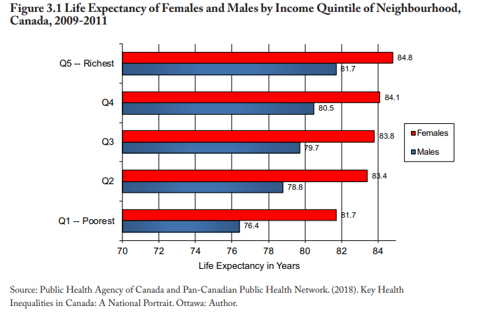

Slide 37
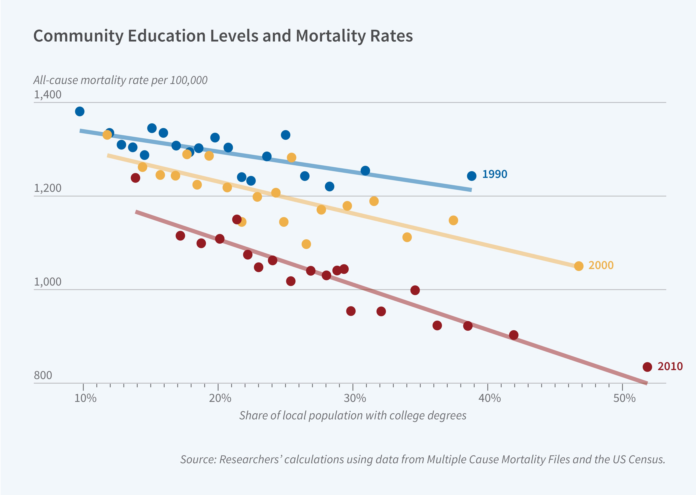
Source: https://www.nber.org/bh/20242/why-do-more-educated-communities-have-better-health-outcomes

Slide 38
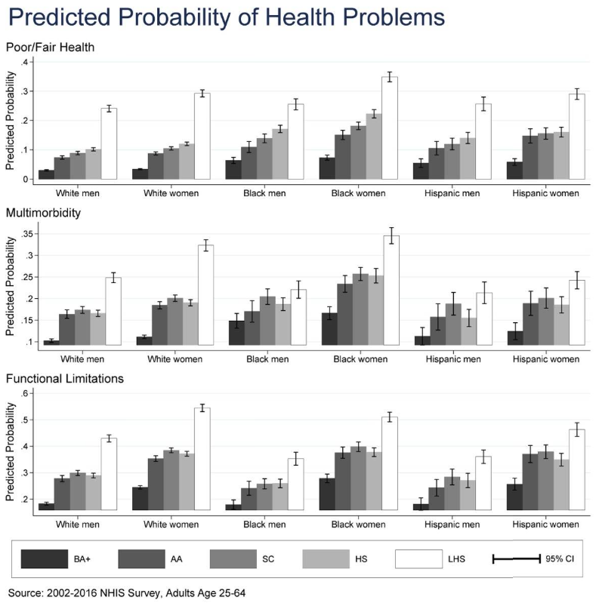
Source: Zajacova, A., & Lawrence, E. M. (2018). The relationship between education and health: reducing disparities through a contextual approach. Annual review of public health, 39, 273-289.

Slide 39
Source: Wait times to see a medical specialist in Canada, 2024 Data table 1

Slide 40
Summary of results on Social Determinants of Health
People have genetic endowments which determine life expectancy, however things like educational attainment appears to also play a role.
Two important relationships are the relationship between education vs mortality and education vs health status.
There are differences between men and women in their wait times for care, however on its own we can't say much (in countries other than Canada there is a paradox).

Slide 41
Concluding Remarks
This lecture we covered:
What is health economics?
Health Expenditures in Canada and the World: A Comparative Overview
Comparing Healthcare Systems- Costs
Comparing Healthcare Systems- Health Outcomes
Comparing Healthcare Systems- Wait Times and Access to Care
Social Determinants of Health

